Slide 1
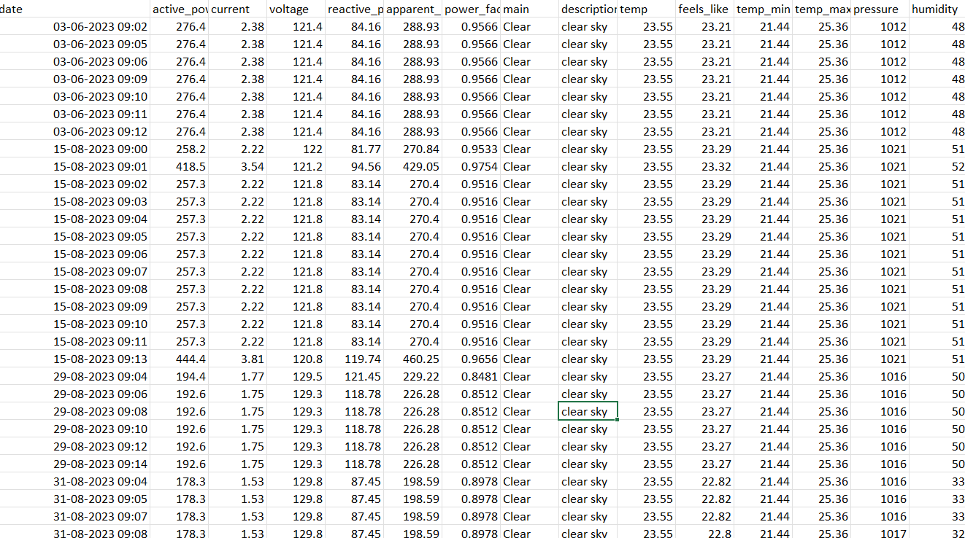
DATASET LINK
Household energy consumption with weather data

Slide 2
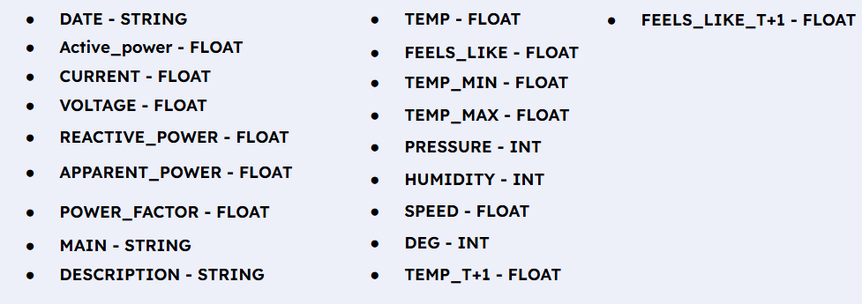
DATA DESCRIPTION AND PREPROCESSING DONE
TOTAL ROWS : 605260
TOTAL COLUMNS : 19
DATA COLUMNS:

Slide 3
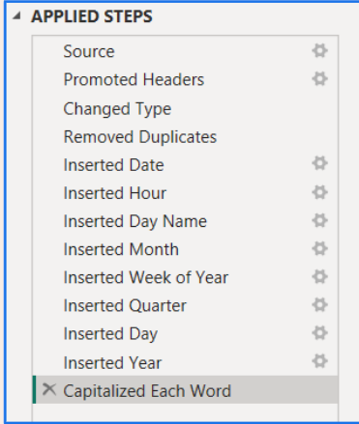
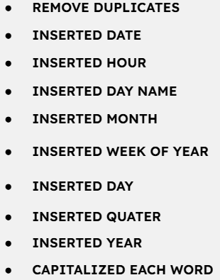
DATA TRANSFORMATION

Slide 4
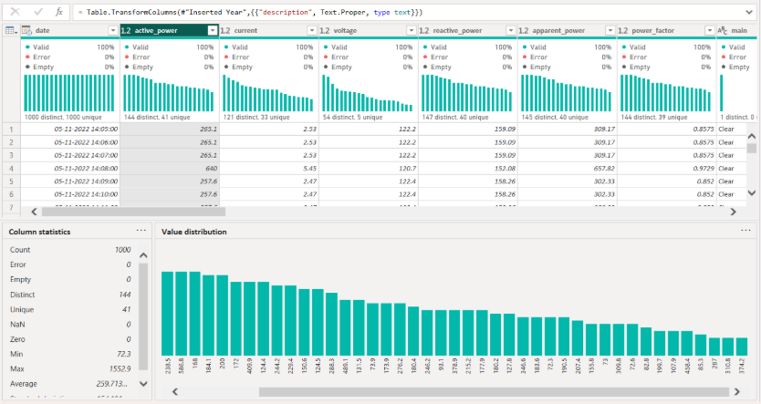
DATA DESCRIPTION AFTER PROCESSING

Slide 5
QUESTIONS THAT CAN BE FRAMED
1. Compare voltage levels across different months when humidity is above 80%.
2. Analyze the change in apparent power between weekends and weekdays when wind speed exceeds 10 m/s
3. Find the top 10 days with the highest apparent power when the pressure is below 1000 hPa.
4. What is the difference in average apparent power on holidays vs working days when humidity is above 60%?
5. What is the correlation between pressure and reactive power during early mornings (0–6 AM)
6. What is the average humidity at different times of the day?
7. Identify time slots (hour ranges) with low voltage (< 110V) during hot and humid days(temp > 32 C , humidity >75%)
8. How does power factor change on days with both low wind speed(speed<3) and low atmospheric pressure(pressure<1000)
9. How does the average active power vary across different hours of the day
10. How does the average atmospheric pressure vary across different weather conditions?

Slide 6
11.What is the most frequent weather condition based on the ‘main’ column?
12.What is the most common sky condition based on the ‘description’ column?
13.How often do extreme weather events like thunderstorms and heavy rain occur?
14.How does temp_max vary between ‘Clear’ and ‘Clouds’ conditions?
15.Is humidity higher during ‘Mist’, ‘Fog’, or ‘Haze’ conditions?
16.How do clear sky and broken clouds temperatures compare at 9 AM?
17.Which weather type has the lowest average feels_like_t+1 temperature?
18.How does the frequency of ‘Clouds’ weather change over the months?
19. Is ‘clear sky’ more common in any specific quarter?
20 .Are rainy days more humid than clear days?
QUESTIONS THAT CAN BE FRAMED

Slide 7
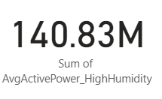
1. Compare voltage levels across different months when humidity is above 80%.
DAX QUERY :
AvgActivePower_HighHumidity =CALCULATE( AVERAGE(energy_weather_raw_data[active_power]), FILTER(energy_weather_raw_data, energy_weather_raw_data[humidity] > 80))
INFERENCE : The sum of Average active power with respect to humidity is 140.83M.

Slide 8
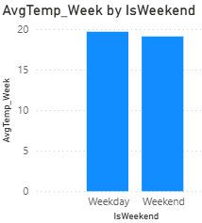
2. Analyze the change in apparent power between weekends and weekdays when wind speed exceeds 10 m/s.
DAX QUERY :
IsWeekend =IF(WEEKDAY(energy_weather_raw_data[date], 2) >= 6,
"Weekend", "Weekday")AvgTemp_Week =AVERAGE( energy_weather_raw_data[temp])
INFERENCE : The change in apparent power between weekends and weekdays when wind speed exceeds 10 m/s where temperature is comparatively higher in Weekday than Weekend.

Slide 9
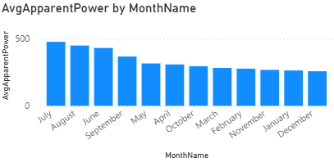
3. Find the top 10 days with the highest apparent power when the pressure is below 1000 hPa.
DAX QUERY :
MonthName =FORMAT(energy_weather_raw_data[date], "MMMM")
AvgApparentPower =AVERAGE(energy_weather_raw_data[apparent_power])
INFERENCE : The top 10 days with the highest apparent power when the pressure is below 1000 hPa is in Month JULY.

Slide 10
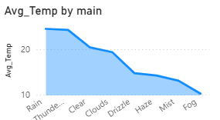
4. What is the difference in average apparent power on holidays vs working days when humidity is above 60%?
DAX QUERY : DayOfWeek =FORMAT ( 'energy_weather_raw_data'[date], "dddd" )
AvgHumidityByDay =AVERAGE ( 'energy_weather_raw_data'[humidity] )
INFERENCE : The difference in average apparent power on holidays vs working days when humidity is above 60% is highest in RAIN and lowest in FOG .

Slide 11
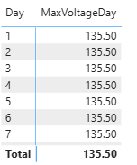
5. What is the correlation between pressure and reactive power during early mornings (0–6 AM)
DAX QUERY : MaxVoltageDay =CALCULATE( MAX(energy_weather_raw_data[voltage]), ALLEXCEPT(energy_weather_raw_data, energy_weather_raw_data[date]))
INFERENCE : The correlation between pressure and reactive power during early mornings is stable
Throughout the weekdays.

Slide 12
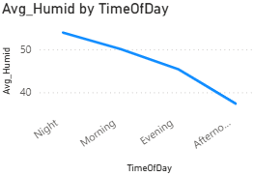
6. What is the average humidity at different times of the day?
DAX QUERY : Avg_Humid = AVERAGE(WeatherData[Humidity])
INFERENCE : The average humidity is higher at night times and lower in Afternoon times.

Slide 13
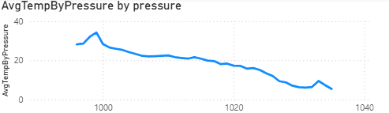
7. Identify time slots (hour ranges) with low voltage (< 110V) during hot and humid days(temp > 32 C , humidity >75%).
DAX QUERY : AvgTempByPressure =AVERAGE (
'energy_weather_raw_data'[temperature] )
INFERENCE : On hot and humid days (Temp > 32°C,Humidity > 75%), the low voltage (<110V) occurs mainly in afternoon to evening slots (1 PM – 7 PM), indicating peak load stress during high demand hours.

Slide 14
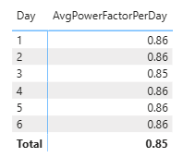
8. How does power factor change on days with both low wind speed(speed<3) and low atmospheric pressure(pressure<1000) ?
DAX QUERY : AvgPowerFactorPerDay =AVERAGE(energy_weather_raw_data
[power_factor])
INFERENCE : During periods of low wind speed (<3) and low atmospheric pressure (<1000), the power factor remains fairly stable (~0.85–0.86), showing no major deterioration. This suggests that power quality is not significantly impacted by these weather conditions.

Slide 15
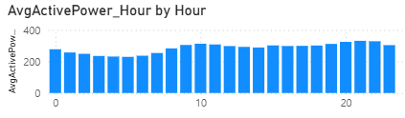
9. How does the average active power vary across different hours of the day?
DAX QUERY : Hour =HOUR(energy_weather_raw_data[date])
AvgActivePower_Hour =AVERAGE(energy_weather_raw_data
[active_power])
INFERENCE : Active power consumption is time-dependent,lowest during early morning (low demand) and highest during late morning and evening hours (peak demand).

Slide 16
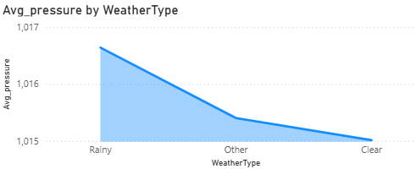
10. How does the average atmospheric pressure vary across different weather conditions?
DAX QUERY : WeatherType =IF(energy_weather_raw_data[main] =
"Rain", "Rainy",IF(energy_weather_raw_data[main] =
"Clear", "Clear", "Other"))AvgPressure =AVERAGE(energy_weather_raw_data[pressure])
INFERENCE : Average pressure is highest during rainy weather, moderate in other conditions, and lowest during clear weather.

Slide 17
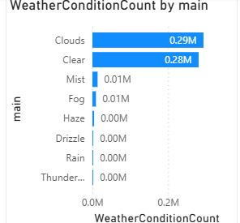
11.What is the most frequent weather condition based on the ‘main’ column?
DAX QUERY :
WeatherConditionCount = COUNTROWS('energy_weather_raw_data’)
INFERENCE : The most frequent weather condition based in ‘main’ column is clouds with around 0.29M data.

Slide 18
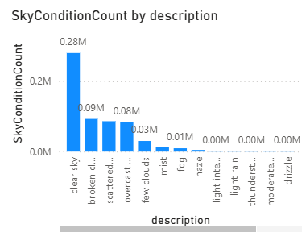
12.What is the most common sky condition based on the ‘description’ column?
DAX QUERY :
SkyConditionCount = COUNTROWS('energy_weather_raw_data’)
INFERENCE : The most common sky condition based on ‘description’ column is clear sky.

Slide 19
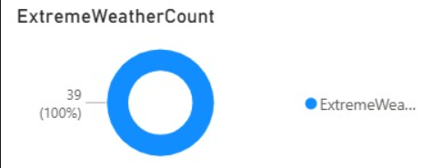
13.How often do extreme weather events like thunderstorms and heavy rain occur?
DAX QUERY :
ExtremeWeatherCount = CALCULATE( COUNTROWS('energy_weather_raw_data'), 'energy_weather_raw_data'[main] IN {"Thunderstorm", "Rain"}, SEARCH("heavy", 'energy_weather_raw_data'[description], 1, 0) > 0)

Slide 20
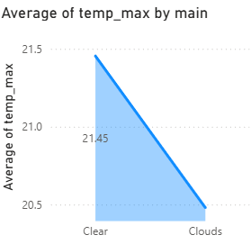
14.How does temp_max vary between ‘Clear’ and ‘Clouds’ conditions?
DAX QUERY :
AvgTempMax = AVERAGE('energy_weather_raw_data'[temp_max])
INFERENCE : The temp_max is comparatively higher in clear condition than clouds condition

Slide 21
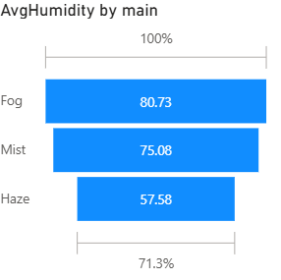
15.Is humidity higher during ‘Mist’,‘Fog’, or ‘Haze’ conditions?
DAX QUERY :
AvgHumidity = AVERAGE('energy_weather_raw_data'[humidity])
INFERENCE :
The humidity is higher during Fog condition than Mist and Haze.

Slide 22
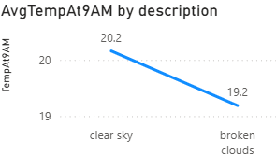
16.How do clear sky and broken clouds temperatures compare at 9 AM?
DAX QUERY :
Hour = HOUR('energy_weather_raw_data'[dt_iso])
AvgTempAt9AM = CALCULATE( AVERAGE('energy_weather_raw_data'[temp]),
'energy_weather_raw_data'[Hour] = 9)
INFERENCE : At 9 AM, the average temperature of clear sky is 20.2 and higher than the broken clouds with 19.2.

Slide 23
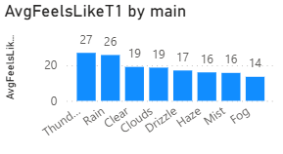
17.Which weather type has the lowest average feels_like_t+1 temperature?
DAX QUERY :
AvgFeelsLikeT1 = AVERAGE('energy_weather_raw_data'[feels_like_t+1])
INFERENCE : Fog has the lowest average feels like t+1 temperature with 14 degrees.

Slide 24
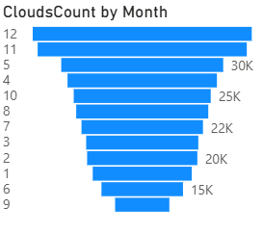
18.How does the frequency of ‘Clouds’ weather change over the months?
DAX QUERY :
Month = MONTH('energy_weather_raw_data'[dt_iso])
CloudsCount =CALCULATE( COUNTROWS('energy_weather_raw_data'),
'energy_weather_raw_data'[main] = "Clouds")
INFERENCE :The cloud count is comparatively higher in month 12 and the least in month 9 as it depends on the change of season .

Slide 25
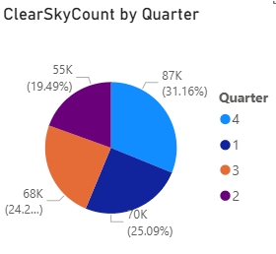
19. Is ‘clear sky’ more common in any specific quarter?
DAX QUERY :
Quarter = QUARTER('energy_weather_raw_data’
[dt_iso])
ClearSkyCount = CALCULATE(COUNTROWS('energy_weather_raw_data'), 'energy_weather_raw_data'[description] =
"clear sky")
INFERENCE :The ‘clear sky’ is most common in quarter 4 with 87K and least in quarter 2 with 55K .

Slide 26
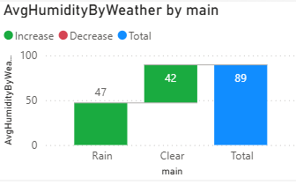
20 .Are rainy days more humid than clear days?
DAX QUERY : AvgHumidityByWeather = AVERAGE('energy_weather_raw_data'[humidity])
INFERENCE :The increase of humidity in Rainy days is higher than clear days where rainy day’s humidity and clear day’s humidity ratio is 47:42.

Slide 27
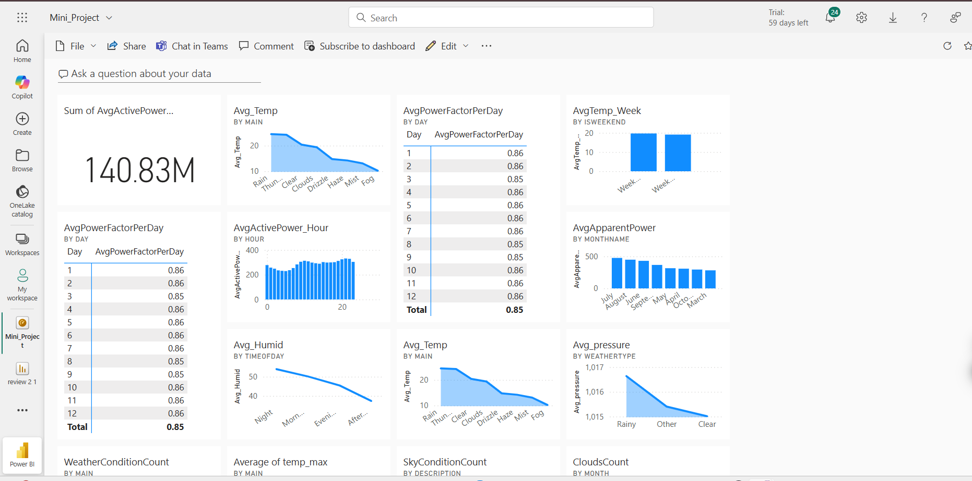
PUBLISHED DASHBOARD
https://app.powerbi.com/groups/me/dashboards/5e1b9584-a7c7-4c4f-91f0-4819ca59da6c?experience=power-bi

Slide 28
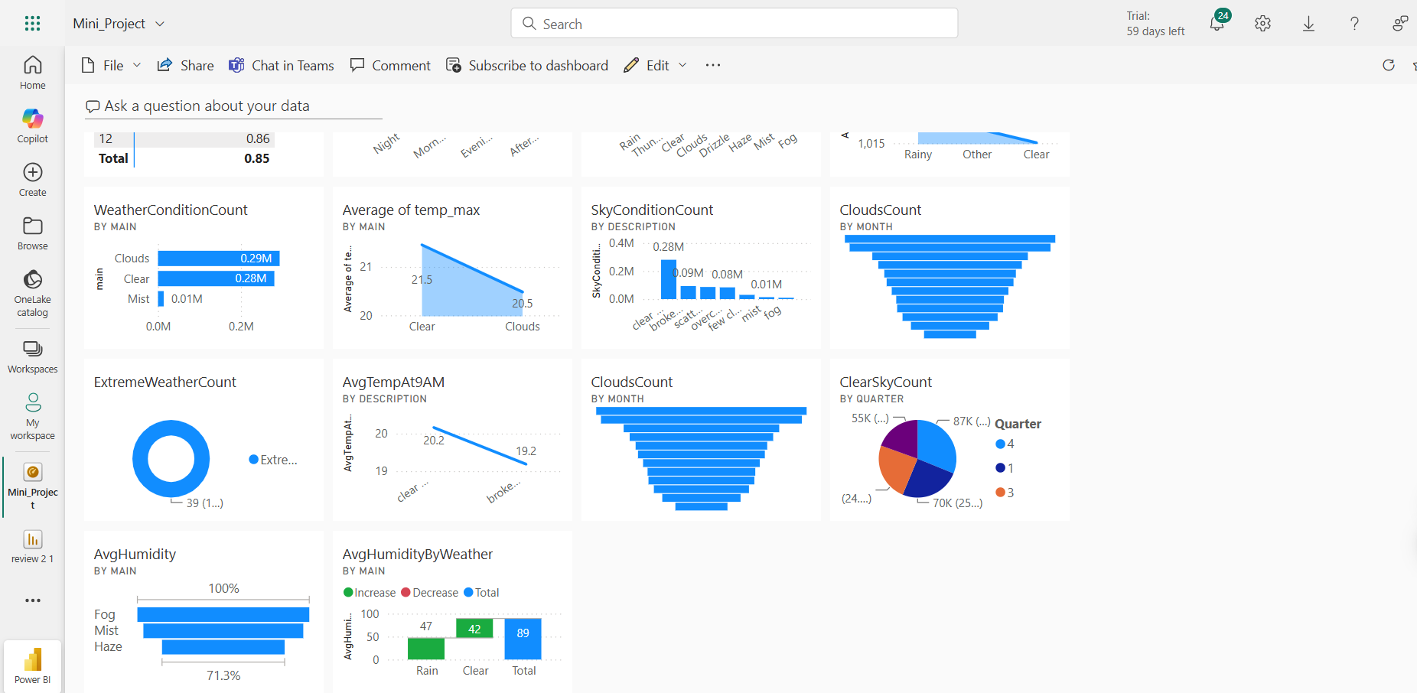
PUBLISHED DASHBOARD

